Slide 1
5G and the Challenges of mm-Waves
By
Jeff Fitih and Steven Jenkins

Slide 2
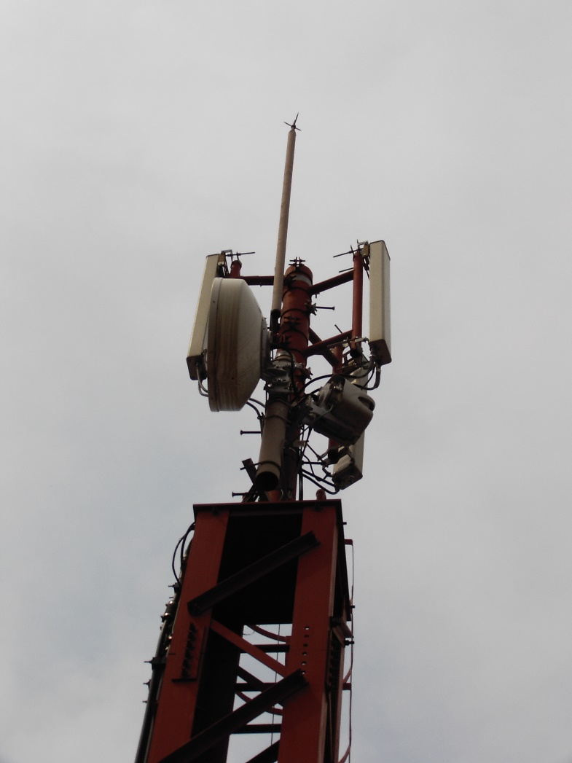
Introduction to 5g

Slide 3
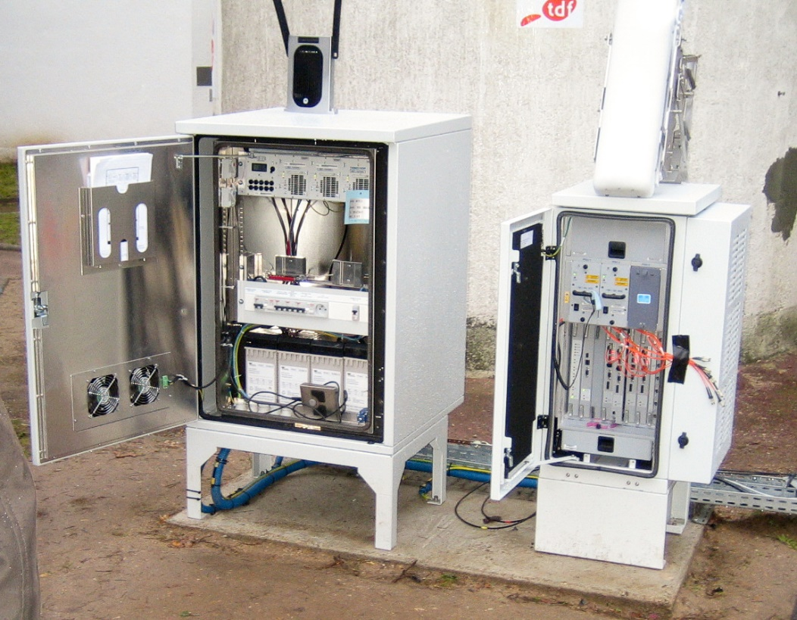
WiMax Equipment

Slide 4
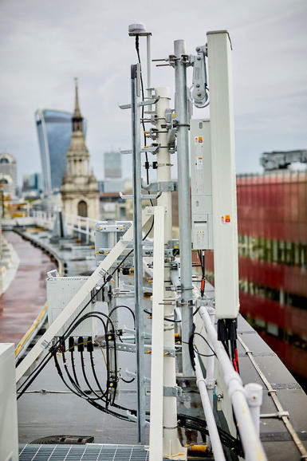
London's 5G trial takes to the rooftops
​1⁄r 4 propagation over the rooftop landscape
diffraction into the "street canyon"
multipath reflection along the street
diffraction through windows, and attenuated passage through walls, into the building
reflection, diffraction, and attenuated passage through internal walls, floors and ceilings within the building

Slide 5
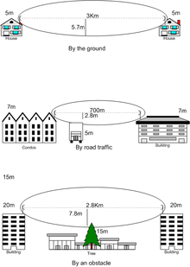


LOS (Line Of Sight)
Impairments to line-of-sight propagation
Line of sight propagation to an antenna

Slide 6
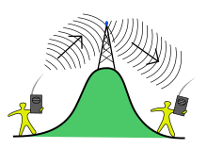
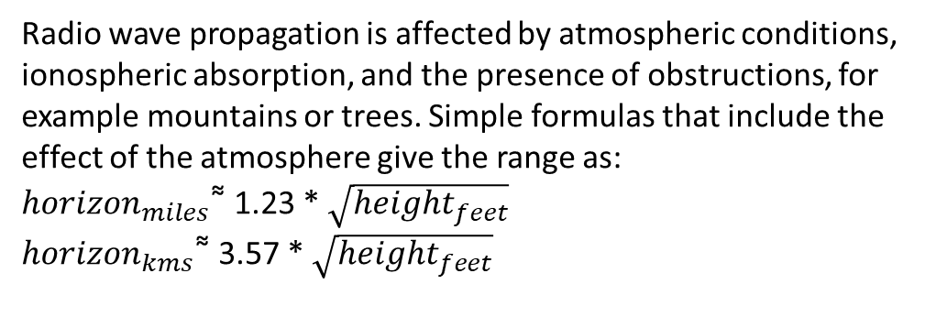
Radio horizon
Two stations not in line-of-sight may be able to communicate through an intermediate radio repeater station.
Radio wave propagation is affected by atmospheric conditions, ionospheric absorption, and the presence of obstructions, for example mountains or trees. Simple formulas that include the effect of the atmosphere give the range as:
${horizon}_{miles }$͌ 1.23 * $\sqrt{{height}_{feet}}$
${horizon}_{kms }$͌ 3.57 * $\sqrt{{height}_{feet}}$

Slide 7

Part of the Atacama Large Millimeter Array (ALMA), a millimeter wave radio telescope

Slide 8
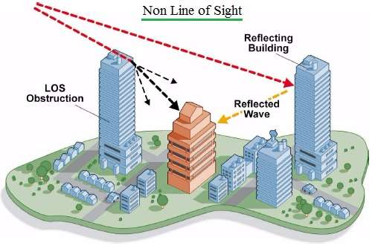
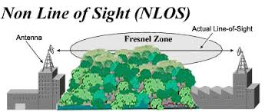
900MHz, Non-Line of Sight, Short Range, Point to Point Wireless Bridge, 8dBi Antennas, High Power, WPA/WPA2

Slide 9
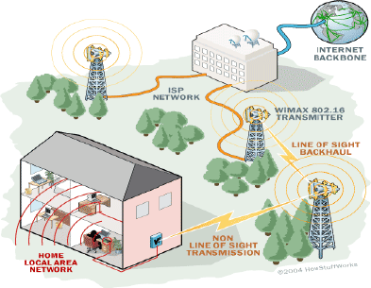
How WiMAX works in a network environment

Slide 10
Routing
This is usually a point to point link between an active base station and a mobile station. Technologies like Opportunity Driven Multiple Access (ODMA) may have flexibility regarding which devices serve in which roles. Some types of wireless connections possess the ability to broadcast or multicast.

Slide 11
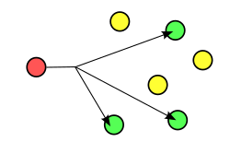
Multicast
Multicast can be one-to-many or many-to-many distribution.
Multicast

Slide 12
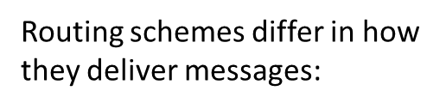
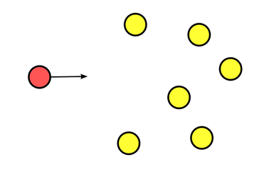
Delivery schemes
unicast delivers a message to a single specific node
broadcast delivers a message to all nodes in the network
multicast delivers a message to a group of nodes that have expressed interest in receiving the message
anycast delivers a message to any one out of a group of nodes, typically the one nearest to the source
geocast delivers a message to a group of nodes based on geographic location

Slide 13
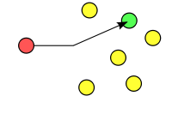
Unicast addressing uses a one-to-one association between a sender and destination: each destination address uniquely identifies a single receiver endpoint.
Unicast addressing

Slide 14
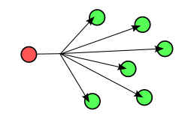
Broadcasting (networking)
All-to-all communication is a computer communication method in which each sender transmits messages to all receivers within a group

Slide 15
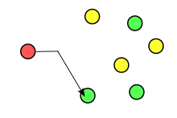
Anycast
Anycast is a network addressing and routing methodology in which a single destination address has multiple routing paths to two or more endpoint destinations. Routers will select the desired path on the basis of number of hops, distance, lowest cost, latency measurements or based on the least congested route.

Slide 16
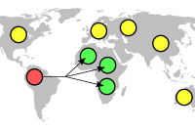
Geocast
Geocast refers to the delivery of information to a group of destinations in a network identified by their geographical locations. It is a specialized form of multicast addressing used by some routing protocols for mobile ad hoc networks.

Slide 17
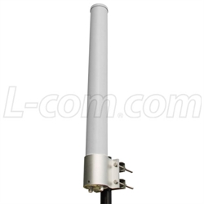
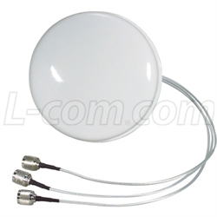
MIMO Antennas(Smart Antenna)
Omni directional MIMO Antennas
Ceiling Mount MIMO antennas
2.4 GHz 3 dBi Spatial Diversity MIMO Ceiling Antenna - 18in N-Female Connectors 2.4 GHz 10 dBi Dual Polarity Omnidirectional MIMO/802.11n Antenna - N-Female Connectors

Slide 18
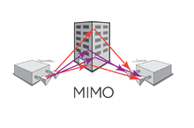
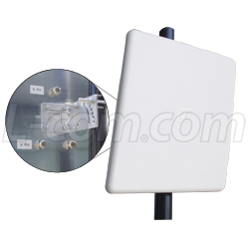
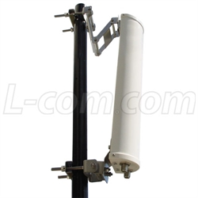
MIMO antenna
Sector MIMO Antennas
Panel MIMO Antennas
Sector MIMO Antennas
2.4 GHz 14 dBi Three Element, Dual Polarized Panel Antenna - N-Female Connectors 4.9-5.8 GHz Dual Polarity 17dBi Sector Antenna

Slide 19
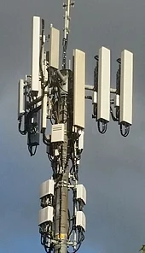
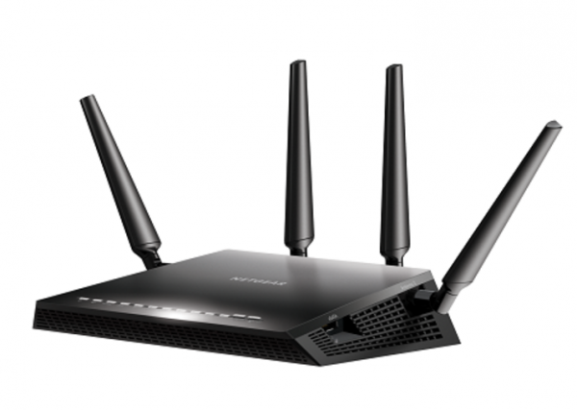
Beamforming
Beamforming or spatial filtering is a signal processing technique used in sensor arrays for directional signal transmission or reception.

Slide 20
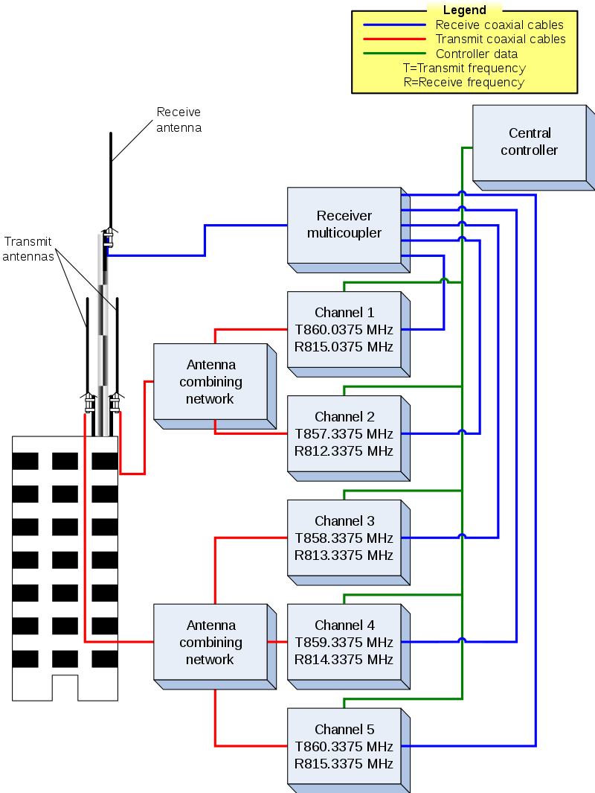
Trunked systems
have groups of base stations configured as repeaters. The center blocks with frequencies in this trunked block diagram each represent a base station.

Slide 21
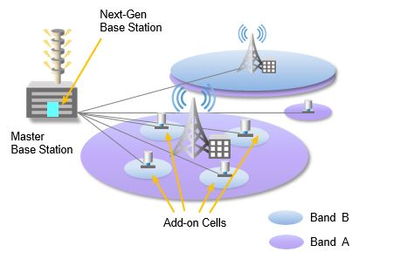
C-RAN Cloud/Centralized Radio Access Network
As the amount of data traffic on mobile networks continues to grow, network operators are meeting the demands by adopting Cloud/Centralized Radio Access Network architectures (C-RAN). This new approach to network architecture has two clear advantages:
Reduced CAPEX/OPEX for operators
Improved user experience through less interference

Slide 22
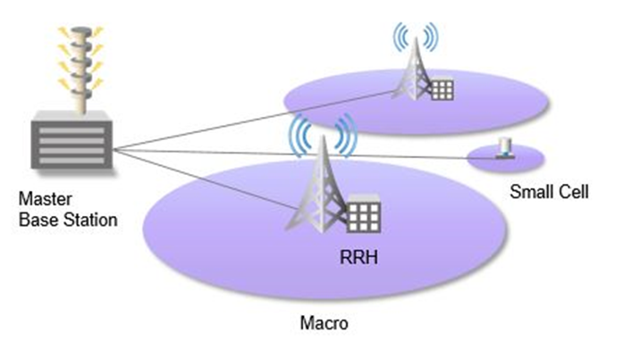
C-RAN Architecture
Separating the base station into two parts, the Baseband Unit (BBU) and the Remote Radio Head (RRH), allows network operators to maintain or increase the number of network access points (RRHs), while centralizing the baseband processing functions into a “master base station”

Slide 23
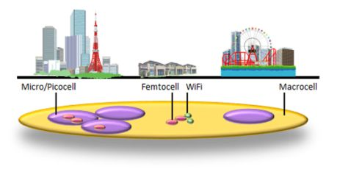
Heteregeneous network (HetNet)
Heterogeneous networks (HetNet) is a term used for modern mobile communications networks. A modern mobile communications network is comprised of a combination of different cell types and different access technologies.
Macro cells are used to provide coverage. Pico cells and micro cells are used to enhance capacity in busy areas, such as train stations, shopping malls and city centers.

Slide 24
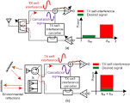
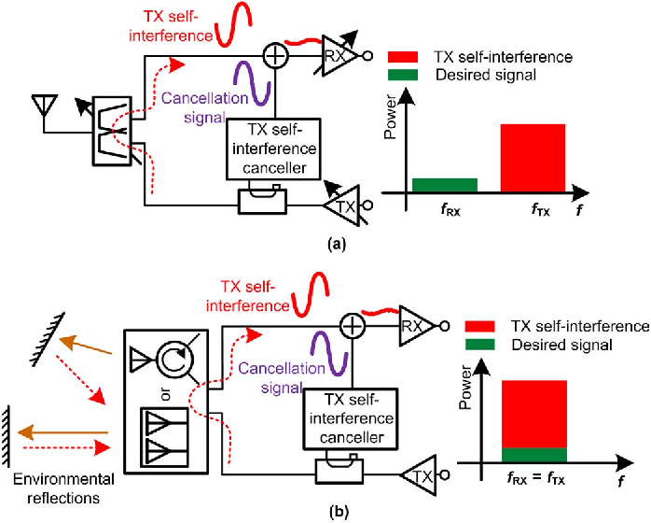

Slide 25
5g and mm waves
Mm waves are required in order to mix 5g and existing wireless tech
Comes with many challenges:
Propagation loss
Penetration
Los communication
Multipath/nlos
Doppler effect

Slide 26
Propagation Loss
Propagation loss is the diluting of waves as they travel, resulting in data loss.
Loss seems to increase at higher frequencies

Slide 27
Loss solutions
Higher loss at higher frequencies is only true for isotropic antennas
Non-isotropic antenna with Shorter wavelenths and higher frequencies have less loss
Allows for smaller antennas which means less space
Also lowers interference

Slide 28
Penetration and LOS Communication
As mm-waves travel they have to pass through or penetrate objects in their path
Common building materials like drywall and concrete have a negative effect on LOS propogation
Human bodies are especially a problem

Slide 29
An Easy fix
Solving the penetration problem is simple
Separating indoor and outdoor traffic
Different nodes should serve different sites.

Slide 30
Multipath and NLOS
Multipath is the ability to receive a signal through more than one path
Human bodies obstruct paths by causing shadowing
NLOS communication require equalizers
Equalizers cause slowdown and propagation loss

Slide 31
Angles
Wider beam width antennas solve multipathing issue
However smaller beam width antennas are much better in most other ways.
True solution requires the correct combination of wide and small beam width antennas placed at the correct angles.

Slide 32
Doppler effect
Causes the waves to reach the destination spread out with different shift values.
This is why small beam width antennas are needed.
Smaller starting beam means smaller spread which alleviates the issue

Slide 33
conclusion
Propagation loss -> higher frequencies, shorter wavelengths, no isotropic antennas
Penetration and LOS communication -> separate indoor and outdoor communication
Multipath and NLOS -> correct angle for antenna with correct combination of beam width
Doppler effect -> small beam width antennas

Slide 34
Any Questions?

